Slide 1

Domain: MATLAB
Technology: COMMUNICATION
AUTOMATIC MODULATION CLASSIFICATION USING PRINCIPAL COMPOSITION ANALYSIS BASED FEATURES SELECTION

Slide 2
Index
Abstract
Introduction
Literature review
Existing Method
Disadvantages
Proposed method
Advantages
Applications
Hardware and Software Requirements
Conclusion
References

Slide 3
Abstract
Automatic Modulation Classification (AMC) is an important task at military environments. Classification needs features, extracting features from samples are quiet difficult, for extracting feature vector with a small length with an useful features, we are implementing Principle Composition Analysis (PCA). Later, two classifiers are used namely K Nearest Neighbours (KNN) classifier and Support Vector Machine (SVM) for classification and a comparative study was also done at both SNRs 3dB and 15dB. At low SNRs both showed almost same results but, at high SNRs KNN showed better results.

Slide 4
Introduction:
Modulation is the process of varying the properties of a signal. Modulation are of several types, such as, Amplitude Modulation (AM), Phase Modulation (PM), Frequency Modulation (FM), Quadrature Amplitude Modulation (QAM), etc. Modulation is a must required process in communication, at exactly Military environments, where we need a fast classification for a better results. So, the classification of modulation schemes are done by many methods one of them are Neural Networks (NN).
Principal Component Analysis (PCA) refers to the analysis of principal component meaning which is the most important component of a signal. PCA reduces the dimensions of the feature vector which is the most important of identification, classification and detection. So, PCA have many applications, we are using one of those applications which classification. Classification is done using Artificial Neural Networks (ANN). There are two types of ANN, which are, Machine Learning (ML) and Deep Learning (DL). For the present work, we are using two ML classifiers known as, K Nearest Neighbours (KNN) classifier and Support Vector Machine (SVM) classifier, which are among the best classifiers in ML.
K Nearest Neighbors (KNN) and Support Vector Machine (SVM) are used for classification, both are easier to implement than the remaining ML or DL classifiers. For, the same purpose, we are also implementing these classifiers. They too need Training and Testing like any other ML or DL or ANN classifiers.

Slide 5
Literature review:
S. NO | Journal Type with year | Authors | Title | Outcomes
1 | 19th European Signal Processing Conference, 29 Aug.-2 Sept. 2011. | Víctor Iglesias, Jesós Grajal, Omar Yeste-Ojeda | Automatic modulation classifier for military applications | Studied about the Automatic modulation classifier at military environments
2 | Wiley, 2014. | Zhechen Zhu and Asoke K. Nandi, | Modulation Classification for Civilian Applications | Studied about classification of modulation at civilian environments
3 | IEEE Trans. Commun., vol.48, pp. 416- 429, 2000. | A. Swami and B. M. Sadler | Hierarchical digital modulation classification using cumulants | Studied about hierarchical Digital modulation classification
4 | Signal Processing, pp. 165-175, 1997 | A. K. Nandi and E. E. Azzouz | Modulation recognition using artificial neural networks | Studied about the recognition of modulation using ANN
5 | IEE Radar and Signal Processing, vol. 137, pp. 459-464, 1990. | S. Z. Hsue and S. S. Soliman | Automatic modulation classification using zero crossing | Studied about modulation classification using zero crossing

Slide 6
Existing methods:
The first proposed Automatic Modulation Classification using Linear Discriminant Analysis (LDA) for extracting features that are used for classification using KNN and SVM.
LDA was used for extracting features from the modulation that are used for classification using the classifiers.
Later, the SVM and KNN are trained and tested feeding the same features generated by LDA.
SVM and KNN showed better results at both training and testing.

Slide 7
Disadvantages in Existing methods:
Feature extraction using LDA is a complex process.
Features extracted using LDA is very complex vector.
Feature vector size determines the efficiency of training and testing, LDA feature vector results in time consuming for training and not that accurate at test results.

Slide 8
Proposed method:
Feature selection based on Principle Composition Analysis (PCA) will generate more robust features with minimized dimensions.
Those features generated by PCA are taken as inputs for training and testing the two classifiers KNN and SVM.
The two classifiers are trained on the features and tested on the testing data and will make a comparison between them.
The classifiers will produce a better results at both training and testing, this is because of the reduced size of feature vector generated by PCA.
PCA will makes the process less complex by reducing the dimensions of the feature vector.

Slide 9
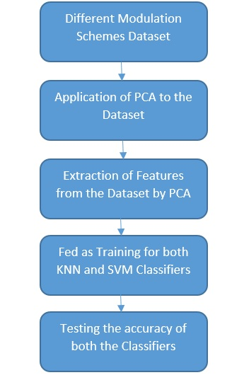
Flow of the proposed method

Slide 10
Advantages of Proposed method:
The main advantage is the dimensions are reduced compared to other existing feature generating processes.
Minimizes time for both training and testing a neural network, in this case, the classifier.
Extracting the better features that maximizes the accuracy and sensitivity.

Slide 11
Applications:
Machine Learning based techniques
Deep Learning based techniques
Detection of objects
Classification of objects, signals and images

Slide 12
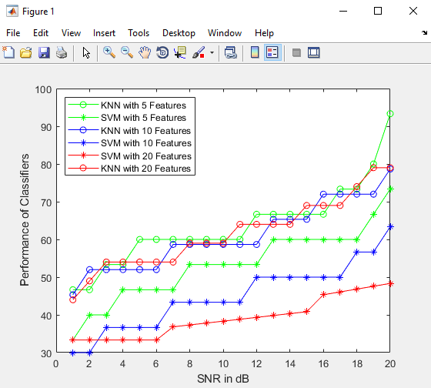
Results

Slide 13
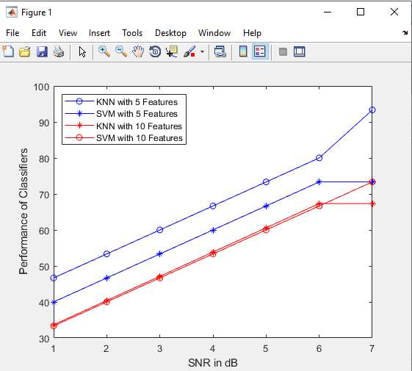

Slide 14
Hardware and Software Requirements:
Hardware & Software Requirements:
Software: Matlab R2018a.
Hardware:
Operating Systems:
• Windows 10
• Windows 7 Service Pack 1
• Windows Server 2019
• Windows Server 2016
Processors:
Minimum: Any Intel or AMD x86-64 processor
Recommended: Any Intel or AMD x86-64 processor with four logical cores and AVX2 instruction set support
Disk:
Minimum: 2.9 GB of HDD space for MATLAB only, 5-8 GB for a typical installation
Recommended: An SSD is recommended a full installation of all Math Works products may take up to 29 GB of disk space
RAM:
Minimum: 4 GB
Recommended: 8 GB

Slide 15
CONCLUSION:
In this significant work, we have implemented a Principle Composition Analysis (PCA) which extracts features from the Modulation techniques dataset. PCA will produce reduced dimension feature vector. The feature vector is used for training and testing the classifiers namely, KNN and SVM. At low SNR environments, both showed almost similar results but, at high SNR environments KNN is better.

Slide 16
References:
[1] Víctor Iglesias, Jesós Grajal, Omar Yeste-Ojeda, “Automatic modulation classifier for military applications,” 19th European Signal Processing Conference, 29 Aug.-2 Sept. 2011.
[2] Zhechen Zhu and Asoke K. Nandi, “Modulation Classification for Civilian Applications,” Wiley, 2014.
[3] A. Swami and B. M. Sadler, “Hierarchical digital modulation classification using cumulants,” IEEE Trans. Commun., vol.48, pp. 416-429, 2000.
[4] A. K. Nandi and E. E. Azzouz, “Modulation recognition using artificial neural networks,” Signal Processing, pp. 165-175, 1997.
[5] S. Z. Hsue and S. S. Soliman, “Automatic modulation classification using zero crossing,” IEE Radar and Signal Processing, vol. 137, pp. 459-464, 1990.

